Slide 1
Deep Fake Detection Rajasthan Police Hackathon 1.0
Team Name: BitwiseOperators Team ID: 1400
- Abhishek R
- Smit Patel
- Anbu Akash Ganesh
-Yogesh M

Slide 2
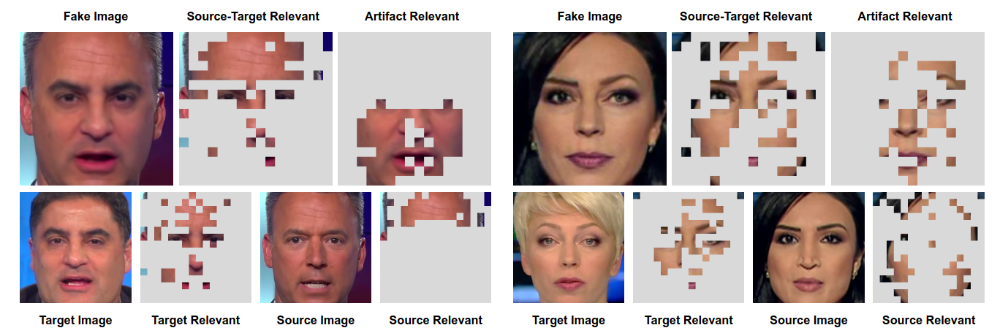
Introduction
Deep fake detection refers to the process of identifying and mitigating manipulated or synthetic media using advanced technologies and algorithms.
The rapid advancement of deep fake technology underscores the urgent need for robust detection mechanisms to combat the risks of misinformation, identity theft and political manipulation.

Slide 3
Problem Statement
The proliferation of deep fake technology poses a serious threat to the authenticity and trustworthiness of multimedia content on the internet. There is a pressing need for effective and scalable deep fake detection systems to identify and mitigate the spread of misleading or harmful content. An interface which is user friendly and aids in deep fake detection to maintain authenticity of content and prevent any causes of disruption in society is developed to meet the requirement.

Slide 4
Motivation
Keeping it Real: We need a solid tool to spot fake videos and audio, so people can trust what they see and hear online.
Stopping the Lies: We're building a system to find and block fake stuff online, so it doesn't mess with the truth and cause problems.
Helping You Decide: This system spots fake content, so you can make better choices online and not fall for tricky stuff.
Helping Society: This system helps to ensure authenticity of content and aid in maintaining harmony in society.

Slide 5
Methodology
Dataset Preparation:
Obtained the Celeb-DF dataset comprising real and deepfake videos for training and evaluation.
Annotation and Labeling:
Annotated the Celeb-DF dataset to label frames as real or deepfake to enable model training.
Face Extraction:
Utilized Dlib for efficient face extraction from the videos which is the preprocessing step for subsequent deepfake detection model training.
4. Model Training:
Implement and train the Mesonet model on the annotated dataset.
Split the dataset into training, validation, and testing sets.
Use data augmentation techniques to enhance model detection accuracy.

Slide 6
Methodology
5. Validation and optimization:
Regularly evaluate and optimize the model on the validation set.
Transfer learning or preprocessing adjustments for improved performance.
6. Evaluation and Deployment:
Assess model performance using metrics like accuracy or F1 score.
Deploy the model into your workflow, integrating it with dlib for face extraction.
Maintain model relevance by updating and retraining against emerging deepfake techniques.

Slide 7
Image Analysis
The dataset consists of fake and real images of celebrities and the dataset is augmented to increase diversity by performing several operations on the images like shearing, zooming, horizontal and vertical shifting.
The deep fake detection system extracts faces from images using dlib module and the extracted faces are then fed into the MesoNet model for detection.
The process allows us to analyse images and determine whether they contain deepfake content.

Slide 8
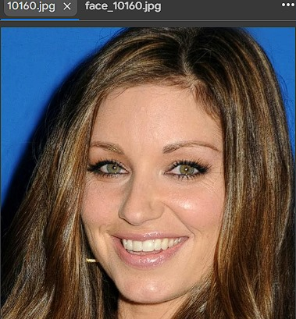
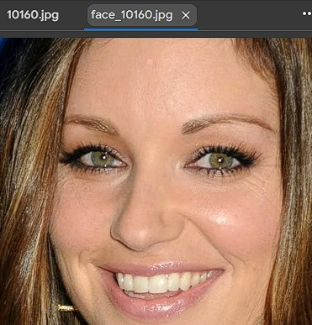
COMPARISION
BEFORE MASKING
AFTER MASKING

Slide 9
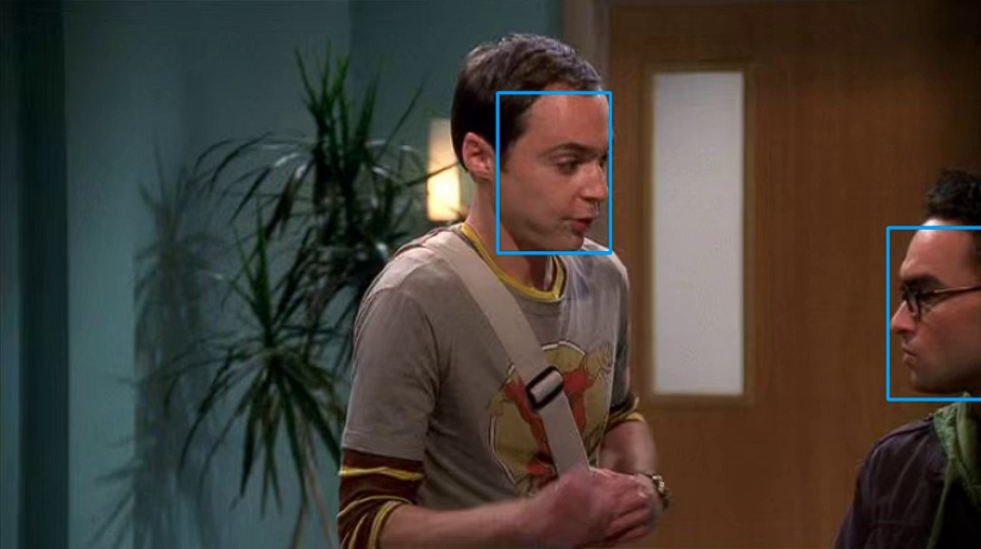
Video Analysis
The video passed is divided into frames using opencv library and the frames are passed for pre processing.
Features like faces are extracted from the frames and are passed to the MesoNet model.
Utilizing dlib for face extraction, the model's performance is evaluated using validation accuracy as the metric.

Slide 10
Resnet Model
Resnet model was built with similar hyperparameters and compared with MesoNet model.
The MesoNet model appeared to exhibit similar performance with slightly better accuracy of 81%.
The dataset used to train the model was “Deepfake and real images” which offered 39,000 images to train with 80-20 train-valid split.

Slide 11
Audio Analysis
CNN model is used for audio analysis. Librosa library is used for loading audio files.
Mel spectrograms for each audio clip is computed. Spectrograms are padded or truncated to a consistent shape.
Data Structure:
X: Mel spectrograms
y: Corresponding class labels (encoded)
Training Data Split: 80% training, 20% validation
Loss Function: Categorical Cross-entropy
Optimizer: Adam
Model is compiled and trained with batch size of 32 and number of epochs set to 10.

Slide 12
Graphical User Interface
The GUI framework is created using Tkinter module which is based on TK GUI toolkit.
Deepfake Audio/Video Classification GUI:
Components:
1. Browse Audio/Video File Button: Allows users to select an audio file (in formats like wav, mp3, or flac).
2. Clear Button: Clears the selected file and classification result.
3. Classify Button: Initiates the classification process for the selected audio/video file.
4. Result Label: Displays the classification result ("Deepfake" or "Real") after classification.

Slide 13
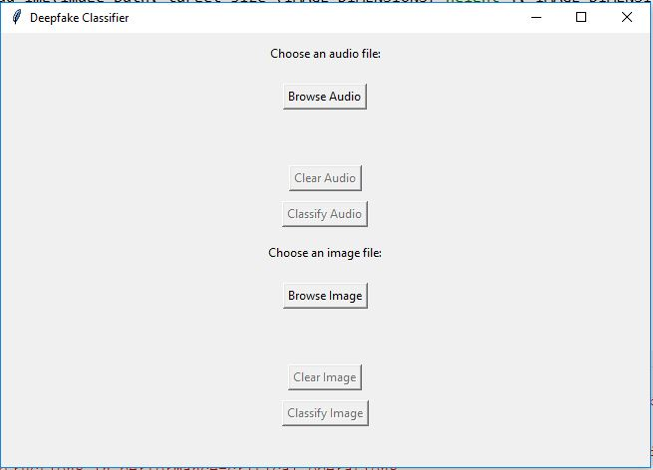
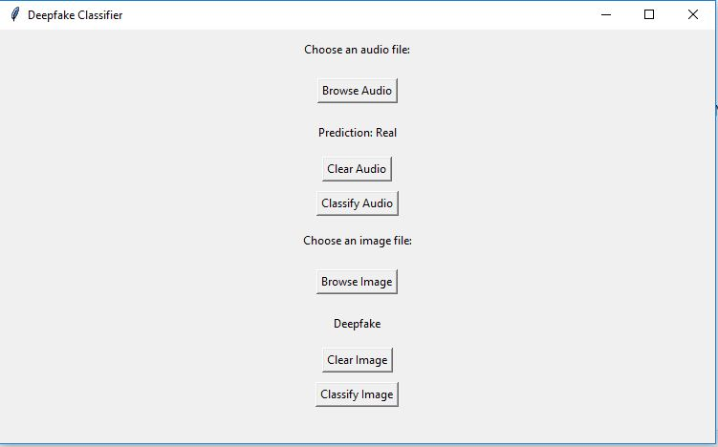
Results
User can choose the audio or image file and pass it to the interface. The file passed will be analyzed and prediction will be displayed.

Slide 14
Challenges and Limitations
Limited Datasets:
The datasets available are limited in this domain and the best performing dataset, DFDC is too large and computationally intensive to be used.
Accuracy:
Maintaining high accuracy across various deep fake methods is difficult as the usage of various techniques to mimic have to be covered which does not yield a good result overall.
Model Maintenance and Updates:
Keeping the models up-to-date with new data, addressing new concerns and maintaining their performance over time can be challenging.

Slide 15
Future Work
Exploring advanced architectures to improve the accuracy or tune the hyperparameters in the current model to improve detection performance.
Expand dataset to ensure data diversity to address a more diverse range of deep fake scenarios.
Implementing a continuous detection pipeline where video, audio and image detection occurs under one interface and updated with emerging patterns and threats.
Incorporating advanced techniques for better feature extraction from files passed to increase the accuracy and aid in detection.
Ensuring good detection accuracy while maintaining the model to be able to detect emerging technologies used for deep faakes.

Slide 16
Conclusion
This project highlights the critical importance of reliable deep fake detection in various media formats.
Accuracy of 80% has been achieved using MesoNet model and a variant of convolutional neural network (CNN) model. This demonstrates the efficacy of our approach across video, image and audio formats.
This journey has provided invaluable insights into the nuances of deep fake detection and the challenges affecting this domain.
The solution presented offers a reliable and quick framework for deep fake detection utilizing the MesoNet model.

Slide 17


